Slide 1
BOBCAT HOLIDAYS, CELEBRATIONS AND TRADITIONS FROM AROUND THE WORLD
BOBCAT TIME DECEMBER 4-8, 2017

Slide 2
MONDAY LESSON
Traditions and Celebrations from around the World
Hopefully you saw the video this morning on FCTV! Bobcats shared a holiday greeting in many different languages!
FCMS is diverse and we want to celebrate our diversity this week as we discuss holidays, celebrations and traditions from our families around the world.
This is one of our school-wide No Place for Hate activities. All Bobcat Time classes should participate.

Slide 3
Traditions and Celebrations from around the World
Every country has holidays that are nationally or culturally important - typically centering on religious festivals, historical traditions and important events in their history.
As the United States is a secular and multicultural society, there are many reasons for why we should learn about faiths, beliefs and traditions other than our own.

Slide 4
Traditions and Celebrations from around the World
Tolerance is accepting the right of others to hold beliefs that are contradictory to our own and not discriminating against them because of those beliefs.
When we understand the differing beliefs and cultures of others, we come to be tolerant and welcoming of it while not being expected to accept the beliefs as equally true.

Slide 5
Traditions and Celebrations from around the World
There are some faiths that do not celebrate or decorate for any holidays, but have traditions.
The more we know about a belief system or philosophy, or of a culture's practices, we are moved to accepting the rights of others to hold those differing beliefs - one of the founding principles of both The Constitution and The Bill of Rights.

Slide 6
Traditions and Celebrations from around the World
Teaching tolerance and understanding helps us become open-minded and accepting.
“Multiculturalism" – is the importance of recognizing that people have both individual and group identities, and that those individual and group identities make up a community, and finally that communities make up the multiculturalism in the country.
Increasing technology means that we are now more than ever before, a truly global community.

Slide 7
Traditions and Celebrations from around the World
Let’s take a peek at some holidays celebrated around the world.
View Celebrating Winter Traditions video on next slide.

Slide 8
Click on video to view “Winter Traditions”. Link if needed: https://www.youtube.com/watch?v=zdehrOwsK-Y

Slide 9
Traditions and Celebrations from around the World
What were some of the similarities in the holidays from the video?
What were some of the differences?

Slide 10
Traditions and Celebrations from around the World
We see similarities in these traditions and ways many people celebrate:
Lighting candles and colorful lights
Sharing festive food with others
Giving small gifts to loved ones
Displaying bright decorations
Singing and listening to music
Giving to the poor and needy
Asking and giving forgiveness
Gathering together with family
Giving thanks
It is interesting to see how some cultures and religions often actually have many things in common.

Slide 11
Tuesday LESSON
Traditions and Celebrations from around the World

Slide 12
Traditions and Celebrations from around the World
The word tradition means:
1. the handing down of statements, beliefs, legends, customs, information, etc., from generation to generation, especially by word of mouth or practice
2. something that is handed down
3. a long-stablished or inherited way of thinking or acting
4. a continuing pattern of culture beliefs or practices.
(dictionary.com)

Slide 13
Traditions and Celebrations from around the World
Family traditions are all of the special things that families do together on a regular basis- whether it’s daily (always eating dinner together), weekly (Friday night movies and popcorn), monthly (game nights), or yearly (for holidays).

Slide 14
Traditions and Celebrations from around the World
In our hectic lives, routine customs create special memories of your family or friends having a great time together, that you will remember and probably pass on to your family.
Adoptive and foster families will also benefit from creating special family traditions and become stronger as they incorporate them into their lives.

Slide 15
Traditions and Celebrations from around the World
EVERYONE SHARE WITH A PARTNER…
THEN SHARE LARGE GROUP.
What are some of your favorite traditions you do with your family or friends? (It might be with extended family or with friends or those you live with).
If you don’t have a tradition, is there something you would like to start doing?
Let’ check in with our Frozen friend Olaf as he searches for a holiday tradition on the next slide.

Slide 16
OLAF'S FROZEN ADVENTURE Movie Clip - Family Traditions (2017) Frozen 2 Disney Animated Movie HD
https://www.youtube.com/watch?v=MVAUKxvLQQo

Slide 17
Traditions and Celebrations from around the World
Tonight- think about and discuss with those you live with your favorite holidays or traditions that you enjoy.
These traditions might be with your extended family or with friends or those you live with.
We will write about these tomorrow.
Now, let’s view more of the celebrations from different religions and cultures.

Slide 18
Traditions and Celebrations from around the World
To enhance mutual understanding and respect among the various religious, ethnic and cultural groups, the Anti-Defamation League offers a Calendar of Observances as a tool to increase awareness and sensitivity about religious obligations as well as ethnic and cultural festivities that may affect students, colleagues and neighbors.
This multi-faith calendar includes significant religious observances of the major faiths represented in the United States.
Click on the following link to view the Calendar of Observances just to see the many different holidays celebrated throughout just one year.
https://www.adl.org/sites/default/files/documents/assets/pdf/education-outreach/CALENDAR-OF-OBSERVANCES-2017.pdf

Slide 19
Wednesday LESSON
Traditions and Celebrations from around the World

Slide 20
Traditions and Celebrations from around the World
Think about a holiday tradition, celebration or just something special that you do with your family or those you live with.
It could be something you do once a week, month or once a year that you will share about.
We will be making a class “Bobcat Family Traditions” poster and posting them in the commons area.

Slide 21
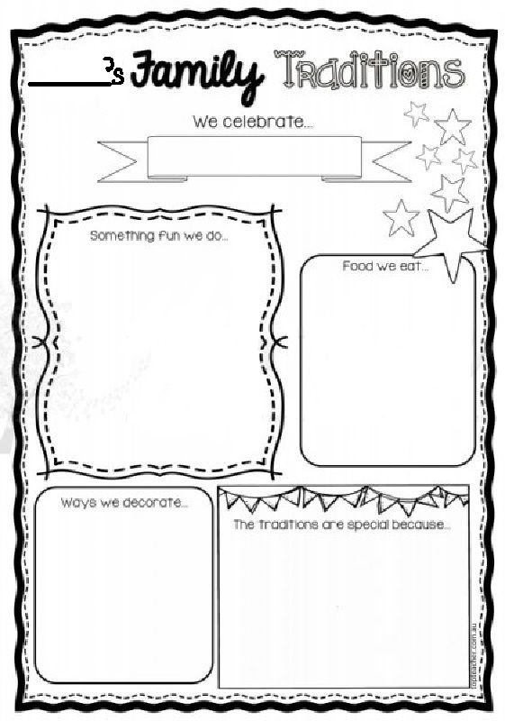
Traditions and Celebrations from around the World
Each student AND TEACHER/ STAFF will fill out their own Family Traditions Paper.
Write and draw pictures to fill it out and color it in using map pencils or crayons.
We will be sharing tomorrow!
(PE classes-Mrs. Kelly will send you materials)
Teachers can collect and keep them until tomorrow if needed.

Slide 22
Thursday LESSON
Traditions and Celebrations from around the World

Slide 23
Traditions and Celebrations from around the World
Teachers share their Family Traditions Paper first!
Each student will share with class
Discuss:
What is one that stood out to you that you might like to start with your family or friends?
Were there any big similarities or differences in some of these traditions?
Why is it important to learn about different celebrations and traditions other people celebrate?

Slide 24
Friday LESSON
Traditions and Celebrations from around the World

Slide 25
Traditions and Celebrations from around the World
Finish presentations and discussion from yesterday if needed.
Discuss:
What is one that stood out to you that you might like to start with your family or friends?
Were there any big similarities or differences in some of these traditions?
Why is it important to learn about different celebrations and traditions other people celebrate?

Slide 26
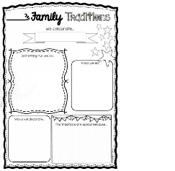
Traditions and Celebrations from around the World
After all presentations, make a title for your poster and glue or tape all of the papers together on your class poster.
Teachers take a picture of your class with their poster and share them with Mrs. Kelly, Mrs. Sanders and Mrs. Laberge.
Send the final poster to Mrs. Kelly. The PALS will hang these in the commons.
Kelly’s Bobcat Time Traditions

Slide 27
Traditions and Celebrations from around the World
If extra time, view another video called Holidays Around the World on the next slide.
*If the video does not play, there is a link on the slide after the video.

Slide 28
Traditions and Celebrations from around the World
Click on link if video does not play.
https://www.youtube.com/watch?v=ux2QpVYPM1s

Slide 29
Traditions and Celebrations from around the World
RESOURCES:
Teacher.org
Adl.org

